Slide 1
PB202 MACROECONOMICS
CHAPTER 4
ROLE OF GOVERNMENT & FISCAL POLICY

Slide 2
Chapter Summary
Arrow Process
Why use graphics from PowerPointing.com?
Definition
Important functions
Contractionary
Expansionary
Discretionary
Automatic
Revenue (tax, non-tax & non-revenue receipt)
Borrowing (internal & external sources)
ECONOMIC FUNCTIONS OF GOVERNMENT
SOURCE OF REVENUE & BORROWING
BUDGET
GOVERNMENT EXPENDITURE
FISCAL POLICY
Definition
Preparation
Types (Balanced, Surplus & Deficit)
Operating
Development
Prepared by: Azlina bt Azmi
Session of December 2010
This illustration is a part of ”Building Plan”. See the whole presentation at slideshop.com/value-chain

Slide 3
Preview
1980 – 1982: Government implemented expansionary fiscal policy to combat recession
Early stages of Asian Crisis: Government tightened the budget to reduce inflationary resulted from the depreciation of RM
1998: Fiscal policy turned expansionary to support economic activity

Slide 4
Economic Functions of Govt
Plays an important role in order to achieve economic stability by implementing economic policy
Create a business environment to encourage competition among producers
To control income disparity through taxation and transfer of payment
To promote private sector as the main engine of economic growth

Slide 5
What is Budget ?
Document contain a preliminary approval plan of public revenue and expenditure in a year
The Finance Minister will announce the National Budget in September or October in Parliament

Slide 6
Types of Budget
Balanced Budget
Occurs when government’s total expenditure is equal with total revenue
Surplus Budget
Total revenue > total expenditure
Deficit Budget
Total revenue < total expenditure

Slide 7
Question
Balanced, Surplus or Deficit
Which one is good or bad?

Slide 8
When?
Surplus Budget
Occurs when government implement during inflation
Which is reduction in Government spending (total expenditure) & increase taxes (total revenue)

Slide 9
When?
Deficit budget
Occurs when government implement during deflation (unemployment & recession)
Increase in Government spending (total expenditure) and reduction in tax (total revenue)

Slide 10
Government Revenues
Is revenue received by government
Is an important part of fiscal policy
In Malaysia, the government revenues can be various such as:
Tax revenues – Direct and Indirect Taxes
Non-tax revenues
Non-revenue receipt

Slide 11
Direct taxes
Direct taxes are collected by the Inland Revenue Board (IRB)
Income tax on individuals and corporation
Petroleum income tax
Stamp duty
Real property gains tax

Slide 12
Indirect Taxes
Indirect taxes are collected mainly by the Royal Customs and Excise Department
Import duties
Export duties
Excise duties
Sales tax
Service tax

Slide 13
Non-Tax Revenues
Non-tax revenues or non-tax receipts are revenues not generated from tax
Revenues that accordance with law and act
Include:
Fees for issue of license and permit
Sale of government assets
Rental of government property
Fines
Return from government investment
Services that government offers

Slide 14
Non-Revenue Receipt
The revenue that not accordance with any law
Consist mainly for
Repayment and reimbursement
Refunds of overpayments in many years
Repayment of loans from government agencies
Payback salary

Slide 15
Types of Tax Structure
Falls into three structures
Proportional Tax
Progressive Tax
Regressive Tax

Slide 16
Proportional Tax
Is a tax which is imposed at the same rate for all income levels
The tax rate remains constant regardless of whether income increases or decreases
Income | 500 | 1000 | 1500 | 2000 | 2500
Total taxes | 25 | 50 | 75 | 100 | 125
Tax rate (total tax/income) | 5% | 5% | 5% | 5% | 5%

Slide 17
Progressive Tax
Is a tax rate which goes on increasing in income
The higher the income, the higher the percentage of tax
Can be charged to obtain revenue to help the poor
Income | 500 | 1000 | 1500 | 2000 | 2500
Total taxes | 25 | 80 | 150 | 240 | 375
Tax Rate (total tax/income) | 5% | 8% | 10% | 12% | 15%

Slide 18
Regressive Tax
Is a tax rate which falls with an increase in income
The higher the income, the lower the percentage rate
Income | 500 | 1000 | 1500 | 2000 | 2500
Total taxes | 50 | 80 | 90 | 80 | 50
Tax Rate (total tax/income) | 10% | 8% | 6% | 4% | 2%

Slide 19
Government’s Borrowing
Also known as ‘Public Debt’ or ‘Public Borrowing’
Occurs when government revenue does not meet the government expenditure
Sources of public debt:
Internal sources
External sources

Slide 20
Internal Sources of Borrowing
Citizens
Sale of securities, bonds and saving certificates
Financial Institutions
Insurance companies invest their resource in the purchase of government securities
Central Bank
Purchase government securities, bonds, debentures from government
Commercial Banks
Invest their deposit in government bonds and securities

Slide 21
External Sources of Borrowing
International money market
Foreign exchange banks, bonds and securities
Currency loans from foreign government
Loans from international financial institutions
International Monetary Fund (IMF) loans in short-term
World Bank loans in long-term basis

Slide 22
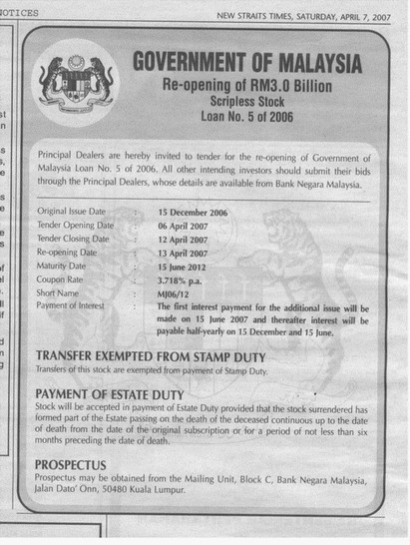

Slide 23
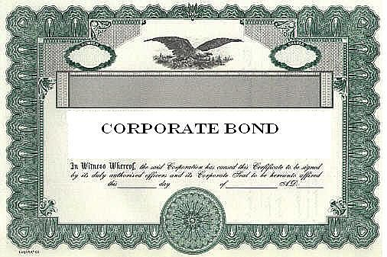

Slide 24
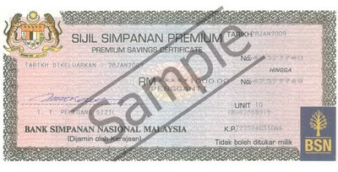

Slide 25
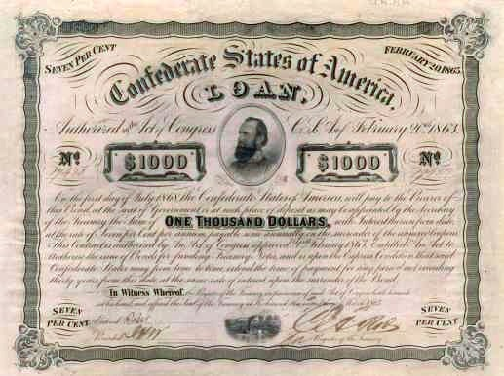

Slide 26
Government Expenditure
The one of main instrument in fiscal policy to increase aggregate demand
Can be classified as transfer of payment and purchases of goods and services
Falls into two categories:
Government Operating Expenditure
Government Development Expenditure

Slide 27
Government Operating Expenditure
To cover the expenses of operating and administering government departments
Consists:
Emoluments
Pensions
Debt
Subsidies
Grants

Slide 28
Government Development Expenditure
For investment purposes to improve facilities in the basic physical infrastructure
Focused on development projects to boost economic growth
Consists:
Defense and security
Economic / sector services
Social services
General administration

Slide 29
Fiscal Policy
The use of government taxation and expenditure to influence the country’s spending, employment and price levels
Instruments of Fiscal Policy:
Discretionary Fiscal Policy
Automatic Fiscal Policy

Slide 30
Discretionary Fiscal Policy
Can be conclude as below:
Discretionary Fiscal Policy
(Tax and Government Spending)
Contractionary Fiscal Policy
Expansionary Fiscal Policy

Slide 31
Automatic Fiscal Policy
Also known as automatic stabilization
Transfer of payment and income tax are automatic stabilizer
Changes in government expenditure (transfer of payment) and taxes (income tax) which occur automatically without government intervention
Because they are change varies with business cycle

Slide 32
Automatic Fiscal Policy
Expansion
Lower transfer of payment
Increase income tax
Recession
Increase transfer of payment
Lower the tax (resulted from drop in income because income tax is progressive tax)

Slide 33
Highlight Budget 2011
Tax
Income tax relief up to RM6,000 for EPF
Import duties and excise duty exemption for hybrid cars extended until 31 December 2011
Import duty and sales tax exemption on broadband equipment until 2011
Sales tax exemption on all types of mobile phones
Service tax be increased from 5% to 6%
Government proposes abolition of import duty on approximately 300 goods preferred by tourist and locals

Slide 34
Highlight Budget 2011
Operating Expenditure
The monthly allowance for KAFA teachers increased to RM800

Slide 35
Highlight Budget 2011
Development expenditure
To support tourism industry, government allocates RM100 million
Allocation of RM146 mil to support oil, gas and energy industry
In agriculture sector, government allocate RM3.8bil to increase productivity and higher returns
The Northern Corridor Economic Region is allocated RM133mil
RM6.4bil to build and upgrade schools, hostels, facilities and equipment

