Slide 1
PB202 MACROECONOMICS
CHAPTER 3
DETERMINANT OF
NATIONAL INCOME EQUILIBRIUM

Slide 2
Arrow Process
Chapter Review
Why use graphics from PowerPointing.com?
Two – sector C+I
Three – sector C + I + G
Four – sector C + I + G + X - M
Consumption (MPC & APC)
Savings (MPS & APS)
Sketch
CIRCULAR FLOW OF INCOME (KEYNES MODEL)
UNDERSTANDING ECONOMICS VARIABLES
MARGINAL & AVERAGE PROPENSITIES
APPROACH
DIAGRAM
Consumption mathematical
Savings function
Investment types &
Government spending factors
AD = AS table &
Leakage = Injection mathematical
methods
This illustration is a part of ”Building Plan”. See the whole presentation at slideshop.com/value-chain

Slide 3
What is circular flow of income?
A diagram shows the flow of products from businesses (firms) to households and the flow of resources from households to businesses

Slide 4
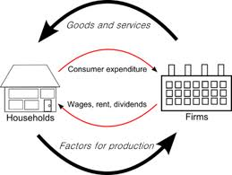
Two-sector (basic)
Flow of products
Top flow
h/holds spend all their income & demand goods & services from firms
firms seek profit by supplying goods & services to h/holds
Bottom flow
firms demand resources from h/holds (land, labor, capital & entrepreneur)
firms pay all resources to h/holds (wages, rent, dividends)
Product market
Factor market
Flow of resources

Slide 5
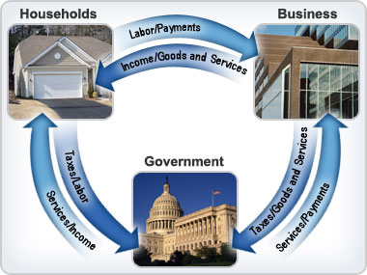
Three-sector

Slide 6
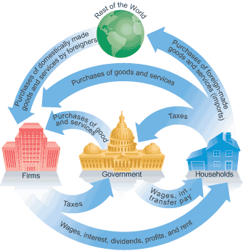
Four-sector

Slide 7
AD = AS Approach
Components in aggregate demand namely consumption, investment, government sector and foreign sector (net exports)
AD = C + I + G + X – M
AS = AD
Y = C + I
Y = C + I + G
Y = C + I + G + X - M
INJECTION = LEAKAGE
I = S
I + G = S + T
I + G + X = S + T + M
2 sector
3 sector
4 sector

Slide 8
Leakage = Injection Approach
Leakage is a withdrawal from the flow of income
Components of leakage are Savings, Taxes & Imports
Reduce national income
Injection is additional into flow of income
Components of injection are Consumption, Government expenditure & Exports
Increase national income

Slide 9
Consumption Theory
John Maynard Keynes – “a person would increase his consumption as income increases, but the expenditure will be less than increase in income”
Consumer will spend only a part of the increase in income and save the rest
This concept can be explain by “Marginal propensities to consume and save”
MPC
MPS

Slide 10
Savings
Is a part of households income not spent
Dependent on disposable personal income (Yd)
Is a leakage component in economy

Slide 11
Marginal Propensity to Consume
The change in consumption resulting from a given change in real disposable income
Mathematically:

Slide 12
Marginal Propensity to Save
Households do a saving with extra dollar that they do not spend
Therefore, we can know how much they spend by using the MPS
MPS is the change in saving resulting change in real disposable income
Mathematically:

Slide 13
Consumption Function
The amount households spend on goods and services at different level of disposable income (personal income after tax)
Formula
C = a + bYd
C = consumption expenditure
a = autonomous consumption
b = marginal propensity to consume (MPC)
Yd = disposable income
MPC + MPS = 1

Slide 14
Savings function
The relationship between savings and the level of income
Savings function can be written as:
S = savings
-a = autonomous savings
1-b = marginal propensity to save (MPS)
Yd = disposable income

Slide 15
Average Propensity to Consume
A ratio of total consumption to real disposable income
APC + APS = 1

Slide 16
Average Propensity to Save
Is the ratio of savings to real disposable income

Slide 17
Investment
Investment is the important component of Aggregate Expenditure (AE) besides consumptions (C ) to develop Keynesian Model
What Keynes says about Investment (I)?
The most volatile components than consumption
Important component in aggregate expenditure
Falls in to two types:
Autonomous investment
Induced investment

Slide 18
Autonomous Investment
Investment that not dependent on the national income
Mainly done with the welfare motive and not for intention of making profits
Examples: construction of road, bridges, school, charitable houses
Not affected by rise in raw materials or wages of workers
Essential to development of nation and out of depression
Curve - inelastic

Slide 19
Autonomous Investment Curve
The curve below
Investment
I
National Income

Slide 20
Induced Investment
Response to changes in national income
Essential for a nation to maintain its stability and economic prosperity
It is done with profit motive
Investment
National income

Slide 21
Determinants of Investment
Rate of interest (r)
Financial cost that firms have to pay when borrowing money capital to purchase the real capital
If r is high, cost of borrowing become expensive thus investment will be lower
Rate of return
Value of return from investment
Higher rate of return will boost investment

Slide 22
Determinants of Investment
Government policies
To attract investors both domestic and foreign
Example: tax exemptions like reduces corporate taxes in order to encourage foreign direct investment (FDI)
Technological change
Improve quality of production and product
New innovations
Attract firms to invest

Slide 23
Government spending
Is the second largest component of aggregate expenditure
Injection component in three sector
Can be considered as autonomous expenditure
Two categories:
purchase of goods & services from firms and h/holds
Transfer of payments – scholarships, pension

Slide 24
Factors of G
Taxes
Economic goal
Political stability

Slide 25
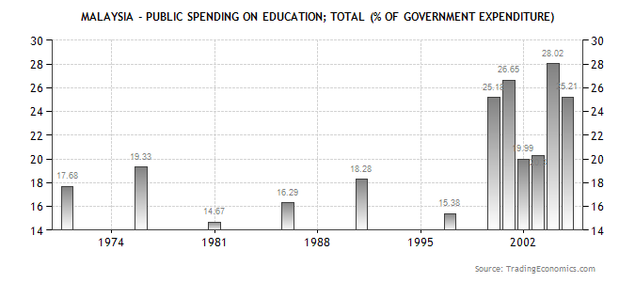
Examples of Government Spending

Slide 26
Budget 2010 – (G)
It’s a good strategy of improving public transport
“RM9bil to finance infrastructure projects including road and bridges projects and rail, sea ports and airports facilities”.
Perhaps what’s happened previously like the wastage in resources due to the inefficient public transport system could be reduced soon.

Slide 27
Budget 2010 – (G)
The personal income tax and corporate tax should be reduced in order to minimize public financial burden and always think in more creative way to help in long-term investment on infrastructure.
“The maximum income tax rate for individuals to be reduced to 26% from assessment year 2010. Personal relief increased to RM9,000.” under Budget 2010 can help the middle income group of people.

Slide 28
Budget 2010 – (G)
“Convert PTPTN loans to scholarships for students who graduate with 1st class honors degree, beginning from 2010″,
This will help to quality education which may increase our nation competitiveness.

