Slide 1
PB202 MACROECONOMICS
CHAPTER 5
MONEY AND MONETARY POLICY

Slide 2
Chapter Summary
Arrow Process
Why use graphics from PowerPointing.com?
Definition
Disadvantages of Barter System
Characteristics of money
Functions of money
Types of money
Definition
Three types (M1, M2, M3)
Quantity Theory of Money (Irving Fisher)
Supply for money curve
The functions
Monetary Policy
DEMAND FOR MONEY
MONEY MARKET EQUILIBRIUM
THE ROLE OF CENTRAL BANK & MONETARY POLICY
THE ROLE OF MONEY IN ECONOMICS
MONEY SUPPLY
Definition
Three purposes of money
Keynes Liquidity Theory
Demand for money curve
Definition
Money market equilibrium curve
Effects of unbalance money market
Prepared by: Azlina bt Azmi
Session of December 2010
This illustration is a part of ”Building Plan”. See the whole presentation at slideshop.com/value-chain

Slide 3
The Role of Money
Definition
Barter system
Characteristics of money
Functions of money
Types of money

Slide 4
What is money?
Money is any commodity that is generally acceptable as a payment for good and services
Money is anything that acts as a medium of exchange

Slide 5
Barter System

Slide 6
What is Barter System?
Before the evolution of money, barter trade was practiced
Barter refer to the direct exchange of one good for another good, rather than for money
For example, if you have rice but wants chickens, you need to find a person who has chickens and willing to exchange his chickens to rice

Slide 7
Disadvantages of Barter System
Lack of Coincidence of wants
Barter transactions can be possible only when two persons desiring exchange of commodities should have such commodities which are mutually needed by each other.
For example, if Ram wants cloth, which Shyma has, then Ram should have such commodity which Shyam wants.
Wasting time in the process of exchange

Slide 8
Disadvantages of Barter System
Lack of Store of Value
In a barter economy, the store of value could be done only in the form of commodities. However, we all know that commodities are perishable and they cannot be kept for a long time in the store.

Slide 9
Characteristics of Money
Liquidity
Money is immediately available to spend without any additional expense
Bon/real estate – to make them liquid, often involve expenses such as brokerage fees & time delays
Portable & Divisible
Easily to reach from our pockets and turn into change to buy items at various price
Uniform
The value of money must be uniform to avoid differences in value

Slide 10
Functions of Money
Medium of exchange
Primary function of money
Removes the problem of coincidence of wants
Providing much more convenient method of exchange

Slide 11
Functions of Money
Money as unit of account
The function of money to provide a common measurement of the relative goods and services
Without money, we face difficulty of pricing goods and services
Example: how many pizzas equals to movie tickets or else?
Only know when we compare with value of money
If the price of one pizza is RM10, and the price of one movie ticket is RM5, then one pizza equals to two movies tickets

Slide 12
Functions of Money
Money as store of value
Serves as store of value in exchange for some item in the future
You can bury money in your backyard, or store it under your mattress for a month or years and not worry of spoiling it
However, inflation can destroy money’s store-in-value function

Slide 13
Types of Money
Commodity money
Is any item that has its own value
Is used as a means of payments
Example: shells, beads, cattle

Slide 14
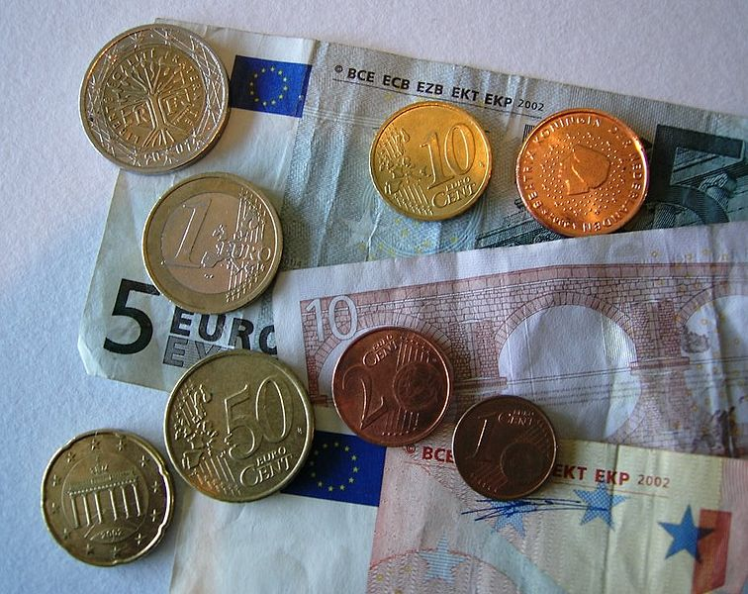
Coins and Bank Notes

Slide 15
Types of Money
Fiat money
‘Fiat’ is Latin word means ‘let it be done’
Is anything that government has ordered or declared to be money
Is issued by Central Bank of a country
Fiat money includes coins and paper money which are called currency

Slide 16
Types of Money
Legal tender
Is paper money that a government has approved to be accepted as a mean of payments
Example: in Malaysia, Ringgit Malaysia (RM) is a legal tender for any payment
All transactions in Malaysia will be in RM

Slide 17
Types of Money
Token Money
Refers to money which has a lower metallic value than its face value
Example: coins produced in Malaysia

Slide 18
Types of Money
Demand deposits
Is money that is transferable by way of cheques
Also known as bank deposits or currents account

Slide 19
QUESTION
Are credit cards money? (6 marks)
Can debit cards be considered as a money? (6 marks)
Find any THREE (3) advantages of barter system
(6 marks)

Slide 20
The Evolution of Money
China gold
History of Money in Malaya

Slide 21
DEMAND FOR MONEY
Definition
Three purpose demand for money
Keynes Liquidity Theory
Demand for money curve

Slide 22
What is Money Demand?
The desire of households and businesses to hold assets in the form of money
Demand for money is sometimes called the demand for liquidity
The liquidity of money leaves people like to hold/demand for money
Questions
Why people tend to hold money?
What purposes people like demand for money?
Will be explain by Keynes Liquidity Theory

Slide 23
Keynes Liquidity Theory
John Maynard Keynes, in his book (1936) The General Theory of Employment, Interest & Money, gave three (3) important motives why people demand for money
Transactions Demand for Money
Precautionary Demand for Money
Speculative Demand for Money

Slide 24
Transactions Demand for Money
People expect to make transactions for goods and services
How much people hold for money is depending on how much they spent on their transactions for goods and services
Example:
A person on vacation might demand more money then on a typical day
Wealthier people might also demand more money because their average daily expenditure are higher than the average people

Slide 25
Precautionary Demand for Money
People like to hold money for unpredictable expenses
Example: car breakdown, hospital, accidents

Slide 26
Speculative Demand for Money
The purpose of people holding money for speculative is to take advantage of expected future changes in the price of bonds, stocks or other financial assets
People like to invest when interest rate is high
Therefore, speculative demand for money is related to interest rate effects

Slide 27
Demand for Money Curve
Arise from three motives for holding money
Represents the quantity of money people hold at different possible interest rates
An inverse relationship between the quantity of money demanded and the interest rate
People hold more money (Md) when interest rate is lower (r )
Md , r

Slide 28
Demand for Money Curve
Interest rate (percent)
r
People will demand more money for transaction and precautions than speculative purposes regardless interest rate is fall or rise
Quantity of money demanded
(RM million)
MDt
MDp

Slide 29
Demand for Money Curve
Interest rate (percent)
MDs
r1
r2
1000
1500

Slide 30
Demand for Money Curve
People tend to hold/demand more money for speculative when they expected interest rate is increase
Interest rate (percent)
People will demand more money for transaction and precautions than speculative purposes when the found interest rate is fall
8
A
4
B
MD
Quantity of money demanded
(RM million)
1,000
1,500

Slide 32
MONEY SUPPLY
Definition
Three types (M1, M2, M3)
Quantity Theory of Money by Irving Fisher
Supply for Money Curve

Slide 33
What is Money Supply?
Money supply is money that control by Central Bank
Money supply does not respond to change in the interest rate
Therefore, the supply for money curve is vertical line
The methods used to measure supply are called M1, M2 and M3

Slide 34
M1: Narrow Money
M1 is the narrowest definition of the supply of money
M1 is also money that directly used for transactions
Consists:
Currency – includes coins and paper money issued by Bank Negara Malaysia
Checkable Deposits – also called as demand deposits
Therefore ; M1 = Currency + Checkable Deposits

Slide 35
M2: Near Money Plus M1
M2 is broader definition of the supply of money
Consists:
M1 (currency and checkable deposits)
Savings and fixed deposits in commercial banks
Negotiable certificate of deposits
Repo
Bank Negara certificates
M2 = M1 + Savings and fixed deposits in Commercial Banks + NCD + Repo + BNM certificates
Or
Near Money = M2 – M1

Slide 36
What is NCD?
With a minimum face value of $100,000
Bought most often by large institutional investor
Money instrument that can easily transferable from one party to another
Can be easily bought / sold between different parties
Example: Yankee CD, issued in US market (New York) by a branch of a foreign bank

Slide 37
What is REPO?
Short term borrowing for dealers in government securities
The dealer sells the government securities to investors, usually on an overnight basis, and buys them back the following day
Classified as a money market-market instrument
Usually raise short-term capital

Slide 38
M3: Broad Money
M3 is the measure of money supply which is the broadest definition
Consists
M2 (M1 + Near Money)
Savings and fixed deposits in the other financial institutions
M3 = M2 + Savings and fixed deposits in other financial institutions
Or
Broad Near Money = M3 – M1

Slide 39
Other Financial Institution
Non-bank private sector
Finance companies
Merchant bank/investment bank
Discount houses

Slide 40
The M1 and M3 Growth

Slide 41
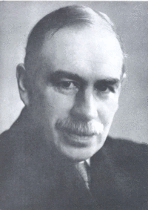
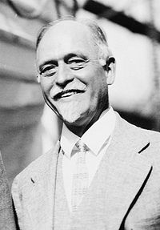
Theory of Money
John Maynard Keynes
Irving Fisher
Keynes Preference Liquidity
The Quantity Theory of Money

Slide 42
Fisher’s Quantity Theory of Money
At the beginning of 20’s century, the economist, Irving Fisher proposed the first explicit equation for calculating the quantity money in economics
Also known as “Fisher equation”, assumed that all the transactions require money to change hand
The quantity theory of money explained that the changes in money supply are related to changes in price level

Slide 43
Fisher’s Quantity Theory of Money
The equation of quantity theory of money as follows:
MV = PQ
M = Money Supply (M1)
V = Velocity of Money
P = Average Price Level
Q = Quantity of output
The money passes from hand to hand, therefore the value of sales will increase
Nominal GDP

Slide 44
Fisher’s Quantity Theory of Money
Any change in the money supply must lead to a proportional change in the price level
Monetary policy based on this theory therefore directly affects the price level

Slide 45
Fisher’s Quantity Theory of Money
Example:
Assume RM20 travels from hand to hand 5 times.
This means the velocity of money is 5, and the equation of exchange is expressed as RM20x5 = RM 100

Slide 46
Fisher’s Quantity Theory of Money
Example:
Consider in Country X has two peoples. One produced carrots, the other produced apples
Every month, each sells a basket of carrots and apples for RM10
In a year, there are 24 transactions, total RM240
In this case, P=10 and T=24. If between them, the two producers have only RM10, so money demand (M) is RM 10, and velocity of transactions (V) equal to 24

Slide 47
Fisher’s Quantity Theory of Money
Example Question:
GDP = RM50,000
M1 = RM10,000
How many times did each ringgit of the money supply have to spent to generate this level of total spending in the economy?

Slide 48
The Supply for Money Curve
Interest rate (percent)
Changes in interest rate will not affect the Money Supply (Ms) in the economy
Ms
Central Bank controls the money supply, at any point in time the supply curve of money is vertical / perfectly inelastic
r 1
r2
The curve shift only according to the decision of the Central Bank
Quantity of money

Slide 49
Money Market Equilibrium
Interest rate (percent)
The equilibrium of interest rate is determined by graphing the money supply curve and money demand curve
Ms
To determine interest rate
r
Md
Quantity of money

Slide 50
Unbalance in Money Market Equilibrium
There are two factors that affect unbalance in money market equilibrium
Monetary policy
Expansionary Monetary Policy
Contractionary Monetary Policy
Real GDP
Economic growth
Recessions

Slide 51
Unbalance in Money Market Equilibrium
Monetary Policy
Expansionary Monetary Policy - leads to increase in money supply. Therefore, the money supply curve shift to the right
Contractionary Monetary Policy – leads to decrease in money supply. Therefore, the money supply curve shift to the left

Slide 52
Unbalance in Money Market Equilibrium
Expansionary Monetary Policy
shift money supply curve to the right
to combat recession
interest rate fall
Interest rate (percent)
Ms
Ms 1
r
r1
Md
Quantity of money

Slide 53
Unbalance in Money Market Equilibrium
Contractionary Monetary Policy
decrease in money supply
to combat inflation
money supply curve shift to the left
interest rate increase
Interest rate (percent)
Ms 1
Ms
r 1
r
Md
Quantity of money

Slide 54
Unbalance in Money Market Equilibrium
Increase in real GDP
means economic growth
change in money demand curve
raise the demand for money because people need more money to make transactions
money demand curve shift to the right
interest rate increase
Interest rate (percent)
Ms
r 1
r
Md 1
Md
Quantity of money

Slide 55
Unbalance in Money Market Equilibrium
Decrease in real GDP
means recession
people decrease demand for money
shift money demand curve to the left
interest rate fall
Interest rate (percent)
Ms
r
r1
Md
Md 1
Quantity of money

Slide 56
Tools of Monetary Policy
Open Market Operation (OMO)
Reserve Requirement Ratio (r.r)
Discount Rate (d.r)

Slide 57
How it’s work
Central Bank (BNM) will used either these THREE tools in order to withdraw/inject the fund (cash) into the banking system
Would be influence money supply in the economy
During inflation, BNM used contractionary policy (reduce Ms)
During recession, BNM used expansionary policy (increase Ms)

Slide 58
What is OMO?
Open market operation
Purchasing & selling of Malaysian Government securities in financial market to influence the size of bank deposits
Government has authorized the BNM to buy and sell government securities
Who is buy/sell this? -------- BNM & banking system
Inflation -------- BNM buys the securities
Recession ------- BNM sells the securities

Slide 59
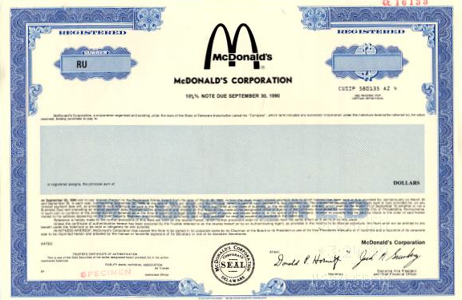
Bond

Slide 60
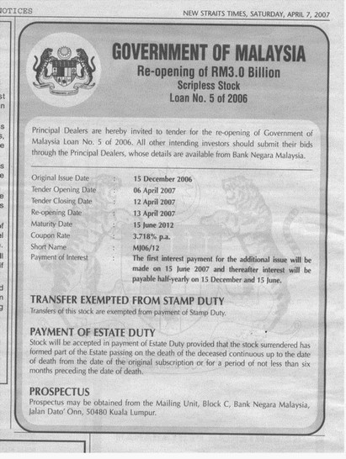

Slide 61
OMO
Decrease the ability of bank to offer a loan
Reduce fund in banking system
(Decrease in Ms)
Recession
(Economic growth below its potential)
BNM would BUY
government securities from financial system

Slide 62
BNM buys bonds from financial market (household/firms/
banking system)
Pay with BNM cheques
They deposit the cheques to their own bank
The bank presents the cheques to BNM as a payment ------ >increase bank deposits ------> bank ability to offer loan to public ------> increase Ms

Slide 63
OMO
Decrease the ability of bank to offer a loan
Reduce fund in banking system
(Decrease in Ms)
Inflation
(Economic growth exceeds its potential)
BNM would SELL
government securities from financial system

Slide 64
OMO
In Malaysia, OMO is not effective as the public holds very little government securities (less than 3%) because low rate of interest
the largest buyers are the insurance companies

Slide 65
Reserve Requirement Ratio (RR)
Regulations on the minimum amount of reserves that banks must hold against deposits
BNM has the power by law to alter the required minimum reserve ratio
Also known as Cash Reserve Ratio (CRR)
Banking institutions (commercial banks, investment banks and Islamic banks) are required to maintain balances in the reserve requirement account base on the reserve requirement rate
reserve requirements influence how much money the banking system can create with each RM of reserves

Slide 66
Decrease (RR)
For example, if the reserve ratio in the Malaysia is determined by the BNM to be 11%, this means all banks must have 11% of their depositors' money on reserve in the bank.
So, if a bank has deposits of RM100,000 it is required to have RM11,000 on reserve account in BNM
Therefore, the balance RM89,000 will hold by bank
Able to give a loan to public
Increase Ms -------> during recession

Slide 67
Increase RR
Now assume BNM has increased the RR from 11% to 20%. This means all banks must have 20% of their depositors' money on reserve in the bank.
If bank has same amount of deposits -----> RM100,000
RM100,000 x 20% = RM20,000 ------> amount required on reserve account in BNM
Balance -----> RM80,000 hold by bank ----> less ability to offer a loan to public
Decrease Ms -----> during inflation

Slide 68
Discount Rate
Banks may borrow from BNM
The interest rate on the loans that BNM makes to banks is called the discount rate
A bank borrows from BNM when it has too few reserves to meet reserve requirements
This might occur because the bank made too many loans
BNM can alter the money supply by changing the discount rate

Slide 69
Discount Rate
Reduces the quantity of reserves in the banking system
Reduce fund in banking system
(Decrease in Ms)
Increase Discount Rate
Discourages banks from borrowing reserves from BNM because the cost of borrowing is higher

Slide 70
Discount Rate
Increase fund in banking system
(Increase in Ms)
Increase the quantity of reserves in the banking system
Decrease Discount Rate
Encourages banks from borrowing reserves from BNM because the cost of borrowing is CHEAPER

Slide 71
The Role of Central Bank
Definition
The functions
The implementation of Monetary Policy

Slide 72
The Role of Central Bank
The Central bank is an important financial institution in every country
It plays an active role in implementing government’s economic policy
Also called as reserve bank or monetary authority
It’s role consist:
Issues the currency
Provide the nation’s money supply
Controlling interest rates
Lender of the last resort

Slide 73
The Functions of Central Bank
Sole right of note issue: The Central Bank has the monopoly note issues governed by certain regulation which is enforced by the state
Banker to the state: The Central Bank acts as a banker and financial adviser to the government that keeps government principal account, manages national debt and holds the cash balances of government
Banker’s bank: it keeps cash reserve to the commercial banks and they can keeps the deposits with the Central Bank

Slide 74
The Functions of Central Bank
Lender to the last resort: The Central Bank helps the member banks in times of crisis
To promote monetary stability and financial structure: in terms of price stability, eradicate poverty and restructuring society
A holder of the country’s stock of gold and foreign currency reserves

Slide 75
The Role of Commercial Banks
Definitions
The functions
Credit creation

Slide 76
Commercial Banks
Plays an important role in today’s financial framework
Is an institution that is owned by the private sector and is profit-making institution
Earning income from providing banking services (opening current and savings account, safe deposit boxes, etc)
Local commercial banks – Affin Bank Berhad, AmBank (M) Berhad, Malayan Banking Berhad
Foreign commercial banks – Citibank Berhad, HSBC Bank (M) Berhad

Slide 77
Functions
Accepting deposits from customers – savings deposit and fixed deposits
Provide loans and advances – housing loans, car loans, education loans, personal loans to the public and earn profits by imposing an interest
Provide other facilities and services – foreign exchange transactions, bank draft, cheques, traveler’s cheque, purchase and sell stock exchange securities, advice on financial matters, ATM machines, credit cards, etc

Slide 78
Credit creation
What is credit creation?
The money that commercial banks supply is called credit creation
The process started from the depositors deposit to the bank
Then bank use the deposit to give loan to the public
But bank cannot lend the entire deposits because they need to fulfill required reserves as stated by Central Bank
The process continues and lead to increase in money supply

