Slide 1
PB102 MICROECONOMICS
CHAPTER 7
MARKET STRUCTURE EQUILIBRIUM

Slide 2
What is Market Equilibrium?
A firm is in equilibrium when it earns maximum profit or when minimum losses occur

Slide 3
MARKET STRUCTURE EQUILIBRIUM
SHORT – RUN EQUILIBRIUM
Total Approach
Marginal Approach
SHUT – DOWN POINT
LONG – RUN EQUILIBRIUM

Slide 4
Short-run Equilibrium
Short –run means a period in which at least one of the input is fixed
Is about how the industry or firms maximize their profits
Has two approaches to determine profit maximization
Total Approach
Marginal Approach

Slide 5
Perfect Competition
Quantity | Total Revenue | Total Cost | Profit/Loss
0 | 0 | 60 | -60
1 | 100 | 140 | -40
2 | 200 | 210 | -10
3 | 300 | 290 | 10
4 | 400 | 390 | 10
5 | 500 | 500 | 0
6 | 600 | 630 | -30
7 | 700 | 800 | -100

Slide 6
Perfect Competition
Total Approach
TC
TR

Slide 7
Perfect Competition
Q | TR | MR | TC | MC | Profit/Loss
0 | 0 | - | 60 | - | -60
1 | 100 | 100 | 140 | 80 | -40
2 | 200 | 100 | 210 | 70 | -10
3 | 300 | 100 | 290 | 80 | 10
4 | 400 | 100 | 390 | 100 | 10
5 | 500 | 100 | 500 | 110 | 0
6 | 600 | 100 | 630 | 130 | -30
7 | 700 | 100 | 800 | 170 | -100

Slide 8
Perfect Competition
Marginal Approach
MC
100
MR
4

Slide 9
Short – run equilibrium
In the short run, perfect competition firm will enjoy THREE types of profit:
Supernormal profit
Profit earned when total revenue greater than total cost
TR > TC or P > ATC
Subnormal profit
Economic losses because total revenue less than total cost or price is lower than average total cost
TR < TC or P < ATC
Normal profit
Is a breakeven for the firm to stay in industry
Incurred when total revenue equal is to total cost
TR = TC

Slide 10
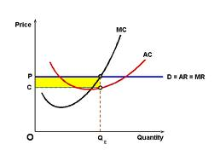
Supernormal Profit

Slide 11
Subnormal Profit
MC
ATC
P
MR

Slide 12
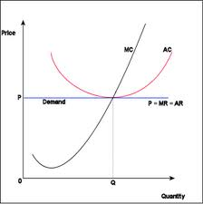
Normal Profit

Slide 13
Long-run Equilibrium
In the long run, firms has enough time to make changes and adjustments to production process
All inputs are variable in the long run
Perfect competition only earn economic profit/normal profit in the long run due to of free entry and exit in industry

Slide 14
Long run Equilibrium

Slide 15
Shut Down Point
If the price is below than average total cost (AVC), firms have TWO possibilities either:
Continue the operation;
Shut down the operation
P < AVC

Slide 16
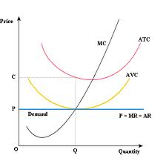
Shut Down Point

Slide 17
Short Run Equilibrium
In monopoly, the short run equilibrium can also be determined by two approaches:
Total Approach
Marginal Approach

Slide 18
Exhibit 5: Short-Run Revenues and Costs for the Monopolist
Short-run Costs and Revenue for a Monopolist
Price Marginal Marginal Average Total
Diamonds (average Total Revenue Total Cost Total Cost Profit or
per day revenue) revenue (MR = Cost ( MC = (ACT = Loss =
(Q) (p) (TR = Q x p) TR / Q) (TC) TC / Q) TC/Q) TR - TC
(1) (2) (3) =(1) x (2) (4) (5) (6) (7) (8)
0 $7,750 0 - $15,000 - - -$15,000
1 7,500 $7,500 $7,500 19,750 4,750 $19,750 -12,250
2 7,250 14,500 7,000 23,500 3,750 11,750 9,000
3 7,000 21,000 6,500 26,500 3,000 8,830 -5,500
4 6,750 27,000 6,000 29,000 2,500 7,750 -2,000
5 6,500 32,500 5,500 31,000 2,000 6,200 1,500
6 6,250 37,500 5,000 32,500 1,500 5,420 5,000
7 6,000 42,000 4,500 33,750 1,250 4,820 8,250
8 5,750 46,000 4,000 35,250 1,500 4,410 10,750
9 5,500 49,500 3,500 37,250 2,000 4,140 12,250
10 5,250 52,500 3,000 40,000 2,750 4,000 12,500
11 5,000 55,000 2,500 43,250 3,250 3,930 11,750
12 4,750 57,000 2,000 48,000 4,750 4,000 9,000
13 4,500 58,500 1,500 54,500 6,500 4,190 4,000
14 4,250 59,500 1,000 64,000 9,500 4,570 -4,500
15 4,000 60,000 500 77,500 13,500 5,170 -7,500
16 3,750 60,000 0 96,000 18,500 6,000 -36,000
17 3,500 59,500 -500 121,000 25,000 7,120 -61,500

Slide 19
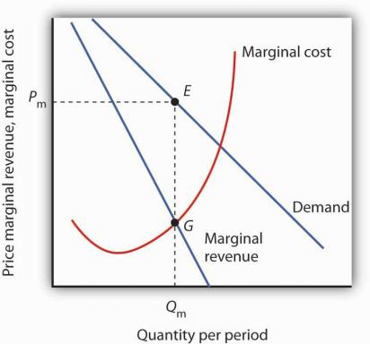

Slide 20
Exhibit 6: Monopoly Costs and Revenue
The intersection of the two marginal curves at point e in panel (a) indicates that profit is maximized when 10 diamonds are sold. At this rate of output, we move up to the demand curve to find the profit-maximizing price of $5,250. The average total cost of $4,000 is identified by point b ➔ the average profit per diamond equals the price of $5,250 minus the average total cost of $4,000 ➔ $1,250 ➔ economic profit is the equal to $1,250 * 10 units sold ➔ $12,500 as shown by the blue shaded area.
(a) Per-Unit Cost and Revenue
Marginal cost
Average total cost
$5,250
a
4,000
Profit
b
Dollars per unit
e
MR
D = Average revenue
0
10
16
32
Diamonds per day
(b) Total Cost and Revenue
Maximum
Total cost
In panel (b), the firm’s profit or loss is measured by the vertical distance between the total revenue and total cost curves ➔ again profit is maximized where De Beers produces 10 diamonds per day
profit
$52,500
40,000
Total dollars
Total revenue
15,000
0 10 16 32
Diamonds per day

Slide 21
Monopolist’s Profit
In short run, monopolist earn THREE types of profit, same as perfect competition
Supernormal profit
TR > TC or P > ATC
Subnormal profit
TR < TC or P < ATC
Normal profit/ Breakeven profit
TR = TC

Slide 22
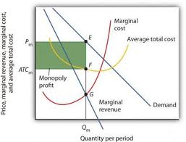
Supernormal Profit

Slide 23
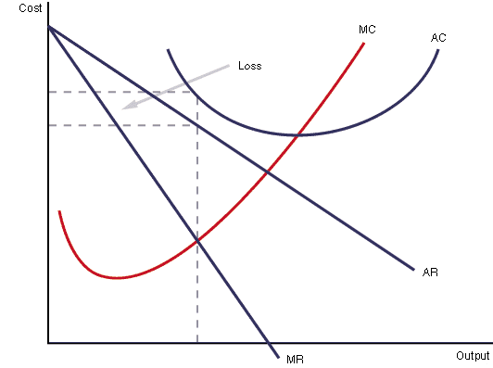
Subnormal Profit

Slide 24
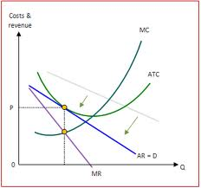
Normal profit

Slide 25
Long Run Equilibrium
In the long run, monopolist will only earn supernormal profits
This is because there are barriers to entry of new firms into the market

Slide 26
Long Run Profit

Slide 27
Monopolistic
Short run Equilibrium
Long run Equilibrium

Slide 28
Short Run Equilibrium
In the short run equilibrium, monopolist firms earn THREE types of profit
Supernormal profit
TR > TC or P > ATC
Subnormal profit
TR < TC or P < ATC
Normal profit
TR = TC

Slide 29
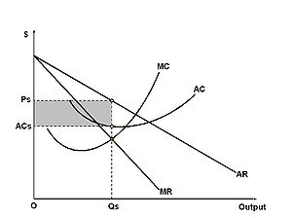
Supernormal Profit

Slide 30
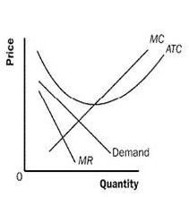
Subnormal Profit

Slide 31
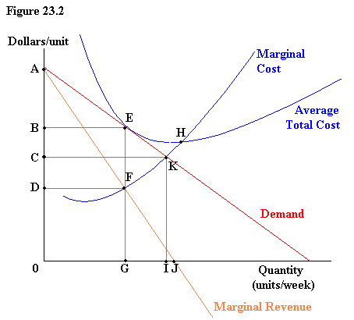
Normal Profit

Slide 32
Long Run Equilibrium
In the long run, a monopolistic competitive firm will earn normal profit

Slide 33
Long Run Equilibrium

