Slide 1
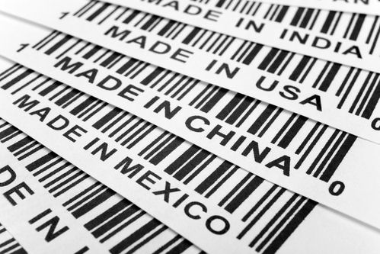
PB202 MACROECONOMICS
CHAPTER 7
INTERNATIONAL TRADE

Slide 2
In this chapter, you will learn to solve these problems
Why international trade is important?
Why countries should specialize in producing certain goods and then trade them for import?
Why some nations applied protectionism rather than free trade?
Would pegging ringgit give more benefit to local business player?

Slide 3
Chapter Summary
Arrow Process
Fixed & floating exchange rate
Gold Standard
Bretton Woods System
Flexible Exchange Rate
Purposes of protectionism policies
Tools of protectionism instruments
Definition
Merits and demerits
Comparison between domestic trade & international trade
ABSOLUTE ADVANTAGE & COMPARATIVE ADVANTAGE
BALANCE OF PAYMENT
PROTECTIONISM
EXCHANGE RATE
INTERNATIONAL TRADE
Definition
Imbalance of BoP
Components in BoP
BoP of Malaysia
The theories about international trade
Prepared by: Azlina bt Azmi
Session of December 2010
This illustration is a part of ”Building Plan”. See the whole presentation at slideshop.com/value-chain

Slide 4
International Trade
Exchange of goods and services between the people of two countries
International trade is exchange of capital, goods, and services across international borders or territories

Slide 5
Malaysia’s Economic View
Since independence in 1957, Malaysia once heavily dependent on rubber and tin
Malaysia today is a middle-income country with a multi-sector economy based on services and manufacturing.
Malaysia is one of the world's largest exporters of semiconductor components and devices, electrical goods, solar panels, and information and communication technology (ICT) products.

Slide 6
Malaysia’s Import and Export
Export Commodities
Import Commodities
Electronic equipment
Petroleum and liquefied natural gas
Wood and wood products
Palm oil
Rubber
Textiles
Chemicals
Electronics
Machinery
Petroleum products
Plastics
Vehicles
Iron and steel products
Chemicals

Slide 7
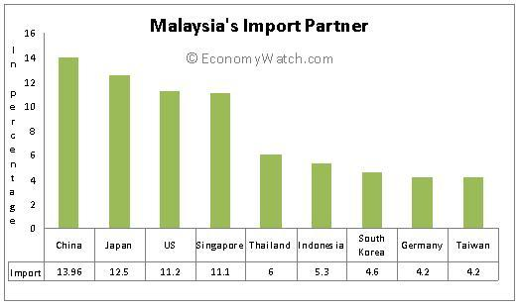
Malaysia’s Import Partner

Slide 8
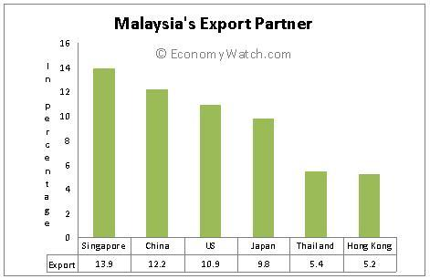
Malaysia’s Export Partners

Slide 9
International Trade Versus Domestic Trade
International trade
Domestic trade
Immobility of factors of production
Comparative advantage in natural resources – increase world output
Differences in monetary units or currencies
Accordance to laws of different countries
Protectionism is practiced
Larger market size
Mobility of factors of production
Using only national resources within the country
Transactions within the country using domestic currency
Accordance only to domestic trade laws
Protectionism is not practiced
Small market size

Slide 10
Merits of International Trade
Increase world output
Through specialization and comparative advantage
Varieties of goods and services
Malaysia can import apples from other countries
Relationship between trading partners
ASEAN, EU
Sharing of knowledge and technology
Malaysia can import new technology-based machinery from Japan

Slide 11
Demerits of International Trade
Depletion of country’s reserves
In long term, continuous exports can deplete the country’s reserve
Example: Oil exports, Palm oil
Economics and political dependence
Political relationship must be taken wisely
Transportation costs
If transportation costs is too high, not profitable

Slide 12
Absolute Advantage Theory
Refers to the ability of a country to produce a product more efficiently than other country
The country enjoyed the production over another country when it uses fewer resources to produce

Slide 13
Absolute Advantage Theory
Country | Cotton | Rice
Malaysia | 20 | 60*
China | 40* | 20
Total | 60 | 80
In this case, Malaysia has absolute advantage in producing rice
While, China has absolute advantage in producing cotton
The international trade between these two countries will increase total output world

Slide 14
Comparative Advantage
This theory proposed by David Ricardo
Refers to the ability of one country to produce goods at a lower opportunity cost than other country
Opportunity cost is the cost of the desired goods that has to be forgone to produced another commodity/goods

Slide 15
Comparative Advantage
Country | Cotton | Rice | Opportunity cost of cotton | Opportunity cost of rice
Malaysia | 60 | 10 | 10/60 = 0.17* | 60/10 = 6
China | 20 | 10 | 10/20 = 0.5 | 20/10 = 2*
Total | 80 | 20
*Indicates lower opportunity cost
Malaysia has lower opportunity cost in production of cotton
China has lower opportunity cost in production of rice
therefore, Malaysia has comparative advantage in producing cotton
China has comparative advantage in producing rice

Slide 16
Comparative Advantage
Malaysia
Cotton | Rice
60 | 10
6 | 1
1 | 0.17
If Malaysia decided to specialize in producing rice, Malaysia has to forgo 6 tons of cotton to produce 1 ton of rice
If Malaysia has decided to produce cotton, about 0.17 tons of rice have to forgo to produce 1 ton of rice

Slide 17
Comparative Advantage
China
Cotton | Rice
20 | 10
2 | 1
1 | 0.5
If China decided to specialize in producing rice, China has to forgo 2 tons of cotton to produce 1 ton of rice
If China has decided to produce cotton, about 0.5 tons of rice have to forgo to produce 1 ton of rice

Slide 18
Comparative Advantage
Country | Cotton | Rice | Opportunity cost of cotton | Opportunity cost of rice
Malaysia | 60 | 10 | 10/60 = 0.17* | 60/10 = 6
China | 20 | 10 | 10/20 = 0.5 | 20/10 = 2*
Total | 80 | 20
Malaysia has to sacrifice only 0.17 tons of rice to produce 1 ton of cotton
while China has to forgo 0.5 tons of rice to produce 1 ton of cotton

Slide 19
Comparative Advantage
Country | Cotton | Rice | Opportunity cost of cotton | Opportunity cost of rice
Malaysia | 60 | 10 | 10/60 = 0.17* | 60/10 = 6
China | 20 | 10 | 10/20 = 0.5 | 20/10 = 2*
Total | 80 | 20
while Malaysia has to forgo 6 tons of cotton to produce 1 ton rice
China has to sacrifice 2 tons of cottons to produce 1 ton of rice

Slide 20
Comparative Advantage
Country | Cotton | Rice
Malaysia | (10/0.17) + 60 = 120 | 0
China | 0 | (20/2) + 10 = 20
Total | 120 | 20
Table above shows the production after specialization
The total world output of cotton increases after specialization

Slide 21
Comparative Advantage
Country | Car | Motorcycle | Opportunity cost of car per unit | Opportunity cost of motorcycle per unit
R | 100 | 300 | 300/100 = 3 motorcycles | 100/300 = 0.3 cars
S | 250 | 350 | 350/250 = 1.4 motorcycles | 250/350 = 0.7 cars

Slide 22
Comparative Advantage
Country | Car | Motorcycle
R | 0 | (100/0.3) + 300 = 633.33
S | (350/1.4) + 250 = 500 | 0
Total | 500 | 633.33

Slide 23
Protectionism Policies
Most countries need protectionism policies to protect local products from foreign competition
There are some purposes/arguments/reasons why some countries need protectionism policies
National security argument
Infant industry argument
Anti-dumping argument
Domestic employment argument
Low foreign wage argument

Slide 24
National Security Argument
Production of goods for war and defense should be produced by country itself
Self-defense production
The country should not depend on other countries to produce security goods especially petrochemicals, munitions, dairy products and rubber.

Slide 25
Infant Industry Argument
Infant or new industries should be protected from established foreign competitors until they experience economies of scale to compete
Example: in order to protect Proton, Malaysia has to impose high tariffs or import quotas on foreign-made cars

Slide 26
Anti-dumping Argument
Dumping is the sale of goods abroad at a lower price or below the price charged in the local market
Dumping is an international price discrimination whereby a company charges more in its home market than in the export market.
Therefore, anti-dumping argument is to protect local goods from foreign goods
Example: if Thailand sells its rice at a lower price than Malaysia, this will be referred to as dumping rice in Malaysia. This will worsen the situation for producers in Malaysia

Slide 27
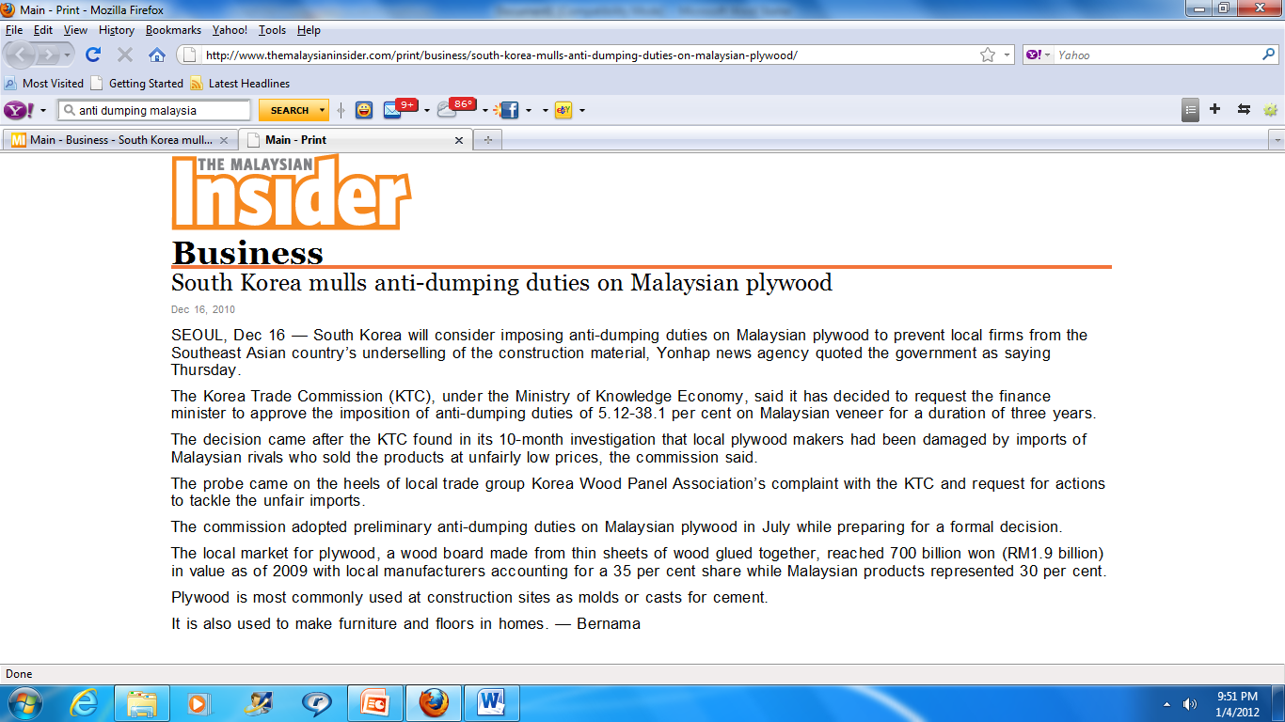
South Korea anti-dumping on Malaysian plywood

Slide 28
South Korea anti-dumping on Malaysian plywood
The Korea Trade Commission (KTC), under the Ministry of Knowledge Economy, said it has decided to request the finance minister to approve the imposition of anti-dumping duties of 5.12-38.1 per cent on Malaysian veneer for a duration of three years.
KTC found in its 10-month investigation that local Korea plywood makers had been damaged by imports of Malaysian rivals who sold the products at unfairly low prices

Slide 29
Domestic Employment Argument
The country needs to practice protectionism and protect domestic employment by reducing imports but increasing exports
Lower domestic output therefore lead to unemployment
Therefore, local producer can compete with foreign producer and can avoid unemployment

Slide 30
Low Foreign Wage Argument
Wages in one country can be higher than those in other country
Example:
Indonesian labor has cheap wages than labor in Malaysia.
Therefore, many Indonesian labor come to work in Malaysia to get paid at higher wages.
This can lead to unemployment for Malaysians if the entry is not controlled

Slide 31
Tools of Protectionism
Tariffs
Specific tariff
Is a fixed tariff imposed on a unit of imported goods
Example: if the tariff is set for an imported perfume is RM20, then the company import 100 bottles, the sum of tariff charged will be RM2000
Ad valorem tariff
is a tariff that imposed on an item on the basis of its value and not on the basis of its quantity, size, weight, or other factor.
Example: a tariff for imported jeans is 20% and the price of jeans is RM200. Thus, the tariff is RM40

Slide 32
Tools of Protectionism
Quotas
Is a legal limit on the number of units of imported goods
Example: the Malaysian government decides to limit the import of television sets from Japan to 10,000 units

Slide 33
Tools of Protectionism
Embargoes
Is a law that bars trade from other country
An embargo may include a ban on goods from countries with different ideologies
Example: Malaysia bans goods from Israel
MASKargo puts embargo on Yemen shipments
Centers for Disease Control and Prevention (CDC) order to embargo bird and bird products imported from Malaysia in 2004.

Slide 34
Tools of Protectionism
Import license
The government control the number of importing firms and the volume of imports through the requirement of import license
This may discourage producers from importing goods
Example: in Malaysia, a limited number of import licenses are given to firms to import cars from foreign countries

Slide 35
Tools of Protectionism
Exchange control
Is a control on the amount of money allowed to be brought into and out of a country
Government regulation on exchange rates as well as restriction on the purchase and sale of foreign currencies
Example: to buy goods from U.S, the domestic producer in Malaysia needs to purchase them into dollars. Restrictions on the amount of US dollars that can be used will reduce the ability to import

Slide 36
Tools of Protectionism
Industry subsidies
The government industries subsidies to protect the domestic firm from competition from abroad by reducing the cost of production and increasing firm’s revenue

Slide 37
BALANCE OF PAYMENT
DEFINITION
COMPONENTS IN BoP
IMBALANCE IN BoP
MALAYSIAN BoP

Slide 38
Balance of Payment
The statement of systematic records of all economic transactions between one country and the rest of the world in a given period of time
Shows a details of the total payments made by one country to other nations and also the total receipts received
BNM’s Monthly Statistical Bulletin

Slide 39
Components in BoP
Current Account
Capital and Financial Account
Reserve Assets

Slide 40
Items | RM Billion
I . CURRENT ACCOUNT
Goods and Services Income Current transfers
II. CAPITAL ACCOUNT
Capital transfers Non produced non- financial assets
III. FINANCIAL ACCOUNT
Direct investment Portfolio investment Other investment
IV. ERRORS AND OMISSIONS
V. OVERALL BALANCE (I+II+III+IV)
VI. RESERVE ASSETS
IMF resources Net Change in Bank Negara Malaysia’s External Reserves

Slide 41
Main Components of Malaysia’s BOP
ITEMS | DESCRIPTION
I. CURRENT ACCOUNT | Inflow & outflow of goods and services into a country
A. Goods and Services | Export and import of physical goods X>M = trade surplus X<M = trade deficit
B. Services | It is about receipts and payments from services such as: Transportation, travel, communications, construction, financial and computer services, royalties and license fees, other professional and business services
C. Income | Payment flows on purchases of foreign assets by Malaysian or Malaysian assets by foreigners

Slide 42
Main Components of Malaysia’s BOP
ITEMS | DESCRIPTION
D. Current Transfers | Includes gifts, military aid and financial aid by the government, NGO and private individuals to foreign countries or from foreign countries. Example: Tsunami at Acheh
III. CAPITAL ACCOUNT
A. Capital transfer | Government and private transfers of fixed assets
B. Non produced non- financial assets | Non-produced is sources needed for production but have not been produced. Example: land and subsoil assets, patents, copyrights, trademarks, franchises

Slide 43
Main Components of Malaysia’s BOP
ITEMS | DESCRIPTION
III. FINANCIAL ACCOUNT | International monetary flows related to investment
A. Direct Investment | Long term capital investment such as purchase or construction of machinery, building, manufacturing, wholesale & retail trade, financial & insurance sectors Outflow – Direct Investment Singapore Australia United Kingdom Inflow – Foreign Direct Investment Republic of Korea Netherlands Japan

Slide 44
Main Components of Malaysia’s BOP
ITEMS | DESCRIPTION
B. Portfolio Investment | External investment in securities and financial derivatives. Purchase of shares, bonds, buying government securities
C. Other investment | External investment other than reserves, direct and portfolio investments. Example: capital flows into bank account or provided loans, short- and long term loans
IV. ERRORS AND OMISSIONS | BoP accountant uses error and omission to balance the account
V. OVERALL BALANCE
VI. RESERVE ASSETS = MINUS OVERALL BALANCE | Monetary gold, foreign exchange assets and other claims

Slide 45
Malaysia Balance of Payments 2007-2008
item

Slide 46
Imbalance in BoP
Occurs when there is a deficit or surplus in the balance of payments
A surplus or deficit shows a country’s strength or weakness
The causes of imbalance is differ from country to country and from time to time
Development programs
Increase in imports
Price effect
Slow progress in exports

Slide 47
Measures to Correct
Export promotion
Export promotion policy is to increase the value of exports
Government can encourage exports by:
Developing quality products with lower price
Improving market strategies
Giving subsidies
Abolishing export duties
Promote local products in international markets
Provide information and helps them to market products globally
Trade agreements

Slide 48
Measures to Correct
Monetary and fiscal policies during inflation
Inflation may increase the prices of locally goods
Will make the imported products more attractive
Foreign investor will reduce their investment
Government will control the inflation by impose tight monetary policies of tight fiscal policies

Slide 49
Measures to Correct
Using government’s reserve
The government’s reserve in the form of gold and foreign currencies are used to balance deficits
Only can be used for a short period
In the long term, government reserve will deplete

Slide 50
Measures to Correct
Devaluation
Is the government’s policy of lowering the par value of country’s currency compared to foreign currency
Makes country’s exports cheap than imported goods
This will stimulate exports because foreigners purchase more goods and services
Imported goods will become more expensive
This method will be used only for a last resort

Slide 51
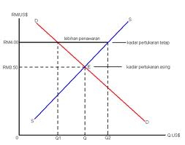
Devaluation

Slide 52
What is Exchange Rate?

Slide 53
Exchange Rate
Can be defined as the price of one currency in terms of another currency
Number of units of one nation’s currency that equals one unit of another nation’s currency
In the past, all currencies were fixed to gold.
Today, a country can fix its value to another country’s currency.
We know the domestic price of the foreign currency

Slide 54
Exchange Rate Rule
RM per dollar , how much RM in terms of 1 dollar of US
Example: RM3 = $ USD 1
Means RM3 per dollar or, RM3 can be exchange for US$1
Now how much US dollar in terms of RM1?
Divided US$1 by RM3, gives US$0.33
Means US$0.33 = RM1

Slide 55
Terms in Exchange Rate
Reciprocal = Can be expressed as reciprocal by divided US$1 by RM3 gives US$0.33
Appreciate = stronger
The number of RM per dollar rises
Assume now exchange rate changes from RM3 =
1USD to RM4 = 1USD, dollar becomes stronger because the number of RM per dollar rises

Slide 56
Terms in Exchange Rate
Depreciate = weaker
The number of RM per dollar declines
Assume now exchange rate changes from RM3 =
1USD to RM2 = 1USD, dollar becomes weaker because the number of RM per dollar declines
In other word, RM becomes stronger / appreciate

Slide 57
Example:
Suppose you are visiting Los Angeles and want to buy a t-shirt with a price tag of US$10
Exchange rate: RM3 = US$1
T-shirt costs RM30 (RM3 x US$10)

Slide 58
Example:
Now assume Britney Spears visiting Malaysia and want to buy Batik at RM200
The exchange rate is RM3 = 1USD, so Britney Spears need to change US dollar to RM (US$1/RM3 = US$0.33)
US$0.33 = RM1
The cost of Batik is US$66 (US$0.33 x RM200)

Slide 59
Floating Exchange Rate
Also known as floating exchange rate
The rate of currency is determined by equilibrium demand and supply in the foreign exchange rate market (market driven)
With floating exchange rates, changes in market demand and market supply of a currency cause a change in value of the currency

Slide 60
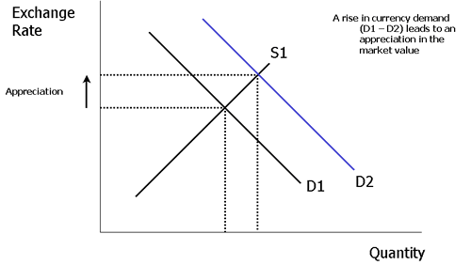
Diagram Floating Exchange Rate

Slide 61
Fixed Exchange Rate
Known as the adjustable-peg system or Bretton Wood system
The countries have to peg their currencies to the US dollar instead of to gold
The currency is determined by government / central bank

Slide 62
Determinants of Exchange Rate
1
Taste and preference
Change in taste
2
Relative income
Change in income
3
Relative price levels
Change in price levels in the country

Slide 63
Question?
Why during Asian Crisis in 1997/98 Malaysian government pegged the exchange rate at RM3.80 per dollar?

Slide 64
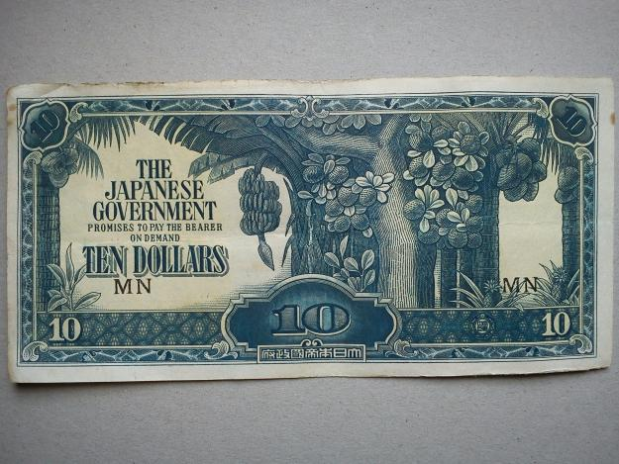
Duit Pokok Pisang Zaman Jepun

Slide 65
Question?
When was Ringgit Malaysia (RM) introduced to replace Malaysian Dollar (M$)?
When the denomination of Ringgit Malaysia was practiced?

Slide 66
Project
Go to money changer, and you need to:
You need to choose one currency and traded RM to that currency
How they determined the price of currency
How they get revenue from the exchange rate?
What information of currency is traded?

Slide 67
The History of Malaysia’s Currency
Formerly known as the Malaysian Dollar (M$)
M$ was linked to Pound Sterling
Malaysia adopted the U.S. Dollar as the intervention currency in place of the Sterling in June 1972
Since June 1973, Malaysia placed the Effective Rate for her dollar on a controlled, floating basis
In August 1975, M$ was officially renamed, known as the Ringgit (RM)

