Slide 1
PB 202 MACROECONOMICS
CHAPTER 1
INTRODUCTION TO MACROECONOMICS

Slide 2
Continuous Assessment
CA | Total | Chapter | %
Quiz | Minimum 3 | Chapter 1, 6, 7 | 20
Test | Minimum 1 | Chapter 1-4 | 20
Tutorial | Minimum 2 | Chapter 2&3 | 20
Case study | Minimum 1 | Chapter 4&5 | 20
Reflective journal | Minimum 3 | Chapter 1, 6, 7 | 15
Peer assessment | Minimum 2 | - | 5

Slide 3
What is Reflective Journal?

Slide 4
Reflective Journal
Points that you found specially interesting in your reading, and would like to follow up in more detail.
Questions that came up in your mind, because of points made in material you read on this topic
Notes from other material you read as a result of the course - whether this was
Your reflections on this course, and how well it is meeting your needs
You may also want to include private thoughts in your journal

Slide 5
How to Study Economics?
Theory and facts
To understand how economic works
Facts without theory are useless
Theory without facts is unsupported assertion
Economic data
To help us think about an economic problem
Two types:
Time series data
Cross-section data

Slide 6
How to Study Economics?
Index numbers
is a statistical measure of changes in a representative group of individual data points
These data may be derived from any number of sources, including company performance, prices, productivity, and employment
Example : Consumer Price Index (CPI), Producer Price Index (PPI).

Slide 7
Why study macroeconomics?
Are you hope to make money?
Are you concerned to learn how budget deficits and inflation will affect you in future?
Are you curious to know why it is sometimes hard to find a job?
Why are some people rich and others poor?
Why foreign like Japan or Korea can produce goods so much cheaply than America?
Why countries like Russia and China are moving from plan to a market economy?
Are you curious to know how the global marketplace works?

Slide 8
What is macroeconomics?

Slide 9
What is macroeconomics?
Macroeconomics can be best understood in contrast to microeconomics
Macroeconomics considers the larger picture which is the sum of all decision
An understanding of microeconomics is crucial to understand macroeconomics
"Macroeconomics is the branch of economics concerned with aggregates, such as national income, consumption, and investment "

Slide 10
Microeconomics versus Macroeconomics
Micro concept | Macro equivalent
Market | National economy
Demand | Aggregate Demand
Supply | Aggregate Supply
Price | Price Level
Quantity | National output/income GDP
Decrease in demand | Recession and unemployment
Decrease in supply | Supply shock; stagflation
Increase in supply | Economic growth
Subsidy | Government spending

Slide 11
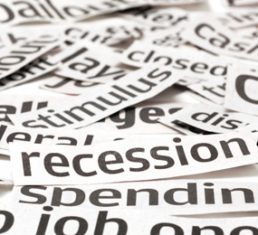
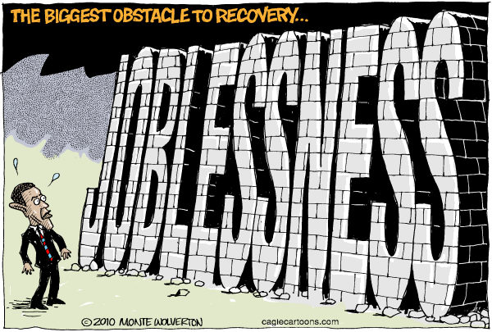
Micro and Macro aims
Goals
Microeconomic aims/goals
Firms aim to maximize profits
Consumers aim to maximize utility
Efficient resource allocation in competitive markets
The correction of market failure through government intervention
Macroeconomic aims/goals
Full employment
Price stability
Economic growth
Income distribution

Slide 12
Macroeconomics Goal
Full employment
Does NOT mean every single person has a job
Means that most people who want to work are working
Price stability
This refers NOT to the prices of individual products, BUT to the price level as a whole
A RISE in the overall price level is called inflation, a FALL is called deflation

Slide 13
Macroeconomics Goal
Economic growth
The most talked about macroeconomic goal
Growth occurs when the total amount of goods and services an economy produces increases from year to year
Equitable distribution of income
A nation’s income should be somewhat equally distributed between the upper and lower “classes” in society
Some tax systems are designed to achieved more equitable income distribution

Slide 14
Macroeconomics Problems
Stagflation
Inflation
Deflation
Hyperinflation
Recession
Unemployment

Slide 15
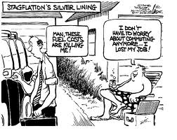
STAGFLATION
Wikipedia - In economics, stagflation is the situation when both the inflation rate and the unemployment rate are persistently high.

Slide 17
STAGFLATION

Slide 18
STAGFLATION
1970’s – global stagflation
Causes :
Yom Kippur war in 1973
Iranian revolution of 1979

Slide 19
Crude Oil Prices 1947-2009

Slide 20
What is inflation?

Slide 21
Inflation
An increase in the price you pay for goods
The rate at which the general level of prices for goods and services is rising, and, subsequently, purchasing power is falling
How do we do when it is inflation?
By using CPI
In Malaysia, Consumer Price Index (CPI) is measured by Dept of Statistic, Malaysia

Slide 23
Inflation in Malaysia 2011
“Inflation is still a concern” – says Tan Sri Dr Zeti Akhtar Aziz (The Star; May 24)
BNM estimate inflation 2.5% to 3.5%
Fiscal policy – cut in government subsidy (gasoline and sugar)
Monetary policy –
BNM increase Overnight Policy Rate (OPR) at 3% the rest of the year ; and increase statutory reserve requirement to 3%

Slide 24
Inflation 2011
As reported by Malaysian Institute Economic Research (MIER), inflation is expected to trend upwards due to the
effects of quantitative easing in the U.S.,
geopolitical tensions in the Middle East and North Africa,
and on the reconstruction of Japan.

Slide 26
Time Series Data
Year | Inflation rate %
1981 | 9.7
1982 | 5.8
1983 | 3.7
1984 | 3.9
1985 | 0.3
1986 | 0.7
1987 | 0.3
1988 | 2.6
1989 | 2.8
1990 | 2.6
1991 | 4.4
1992 | 4.8

Slide 27
Time Series Data
Year | Inflation rate %
1993 | 3.5
1994 | 3.7
1995 | 3.5
1996 | 3.5
1997 | 2.7
1998 | 5.3
1999 | 2.7
2000 | 1.5
2001 | 1.4
2002 | 1.8
2003 | 1.0

Slide 28
Time Series Data
Year | Inflation rate %
2004 | 1.5
2005 | 3.0
2006 | 3.5
2007 | 7.4
2008 | 12.3
2009 | 4.0
Source: The World Bank Data

Slide 29
What is deflation?

Slide 30
Deflation
In general, deflation is when the average price of goods goes down
When the inflation rate falls below zero, showing negative inflation, we know that there has been deflation

Slide 31
What is hyperinflation?

Slide 32
Hyperinflation
Extremely rapid or out of control inflation
Germany – after World War I (inflation rate 322)
In Hungary after World War II - Between August 1945 and July 1946 the general level of prices rose at the astounding rate of more than 19,000 percent per month, or 19 percent per day
Cause – war and increase in money supply

Slide 33
Hyperinflation in Hungary
Sweeping up the banknotes from the street after the Hungarian pengő was replaced in 1946

Slide 34
Hyperinflation in Germany
Germany, 1923: banknotes had lost so much value that they were used as wallpaper.

Slide 35
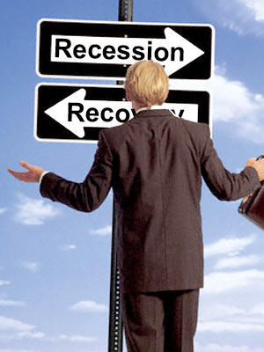
What is recession?

Slide 36
Recession
Period of general economic decline, defined usually as a contraction in the GDP for six months (two consecutive quarters) or longer.
In usual dictionary definition is “ a period of reduce economy activity”
The NBER define a recession as a “significant decline in economic activity lasting more than a few months.”

Slide 37
Recession
Marked by high unemployment, stagnant wages, and fall in retail sales
a recession generally does not last longer than one year and is much milder than a depression

Slide 38
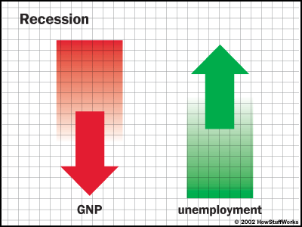

Slide 39
Causes of recession
Currency crisis
Energy crises
Financial crises

Slide 40
Time Series Data
Year (Quarterly) | GDP growth rate at constant price | Unemployment rate
2008: Q1 | 7.4 | 3.6
2008: Q2 | 6.6 | 3.7
2008: Q3 | 4.8 | 3.1
2008: Q4 | 0.1 | 3.1
2009: Q1 | -6.2 | 4.0
2010: Q2 | -3.9 | 3.6
2010: Q3 | -1.2 | 3.6

Slide 41
GDP – real growth rate

Slide 42
What is
Unemployment?

Slide 43
Unemployment
The general economic definition of unemployment is defined as:
a state in which there are qualified workers who are available for work at the current wage rate and who do not have jobs.

Slide 44
Unemployment
as defined by the International Labour Organization (ILO)
occurs when people are without jobs and they have actively looked for work within the past four weeks

Slide 45
Unemployment Rate
The unemployment rate is a measure of the prevalence of unemployment
it is calculated as a percentage by dividing the number of unemployed individuals by all individuals currently in the labour force.

Slide 46
Malaysia Unemployment Rate 2001-2007
Year | Total | Unemployment rate (%) | Labor force rate (%)
2001 | 9357 | 3.5 | 64.9
2002 | 9543 | 3.5 | 64.4
2003 | 9870 | 3.6 | 65.2
2004 | 9980 | 3.5 | 64.4
2005 | 10,045 | 3.5 | 63.3
2006 | 10,275 | 3.3 | 63.1
2007 | 10,538 | 3.2 | 63.2
Source: Dept of Statistics

Slide 48
The end

